Slide 1
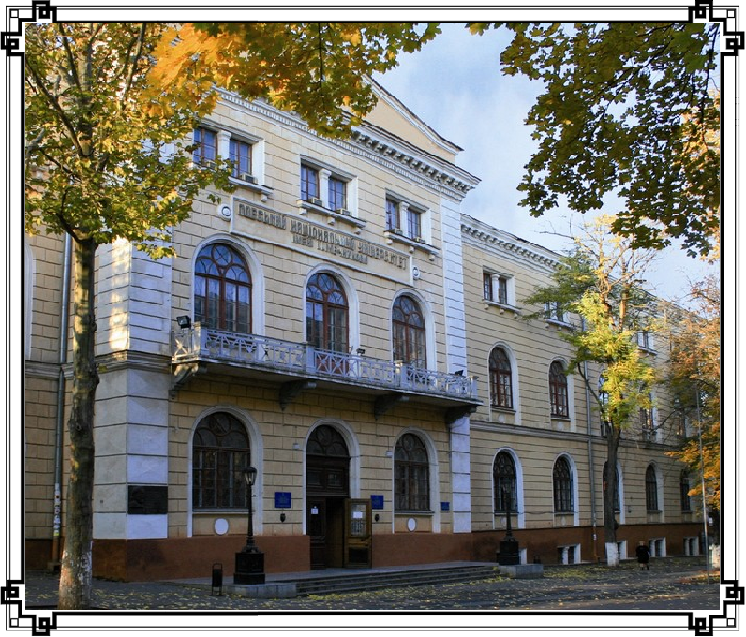
ODESA
I.I.MECHNIKOV NATIONAL
UNIVERSITY
1865

Slide 2
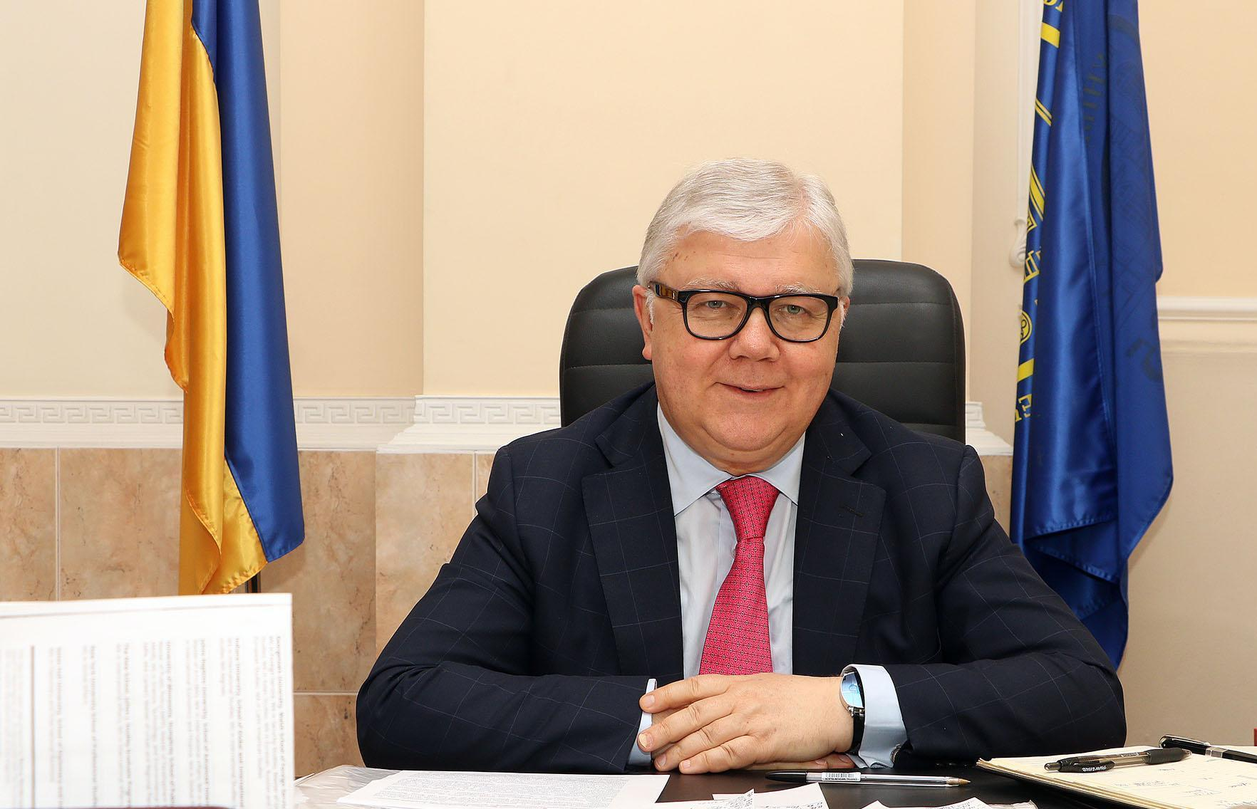
RECTOR
of Odesa I. I. Mechnikov National University
Dr.Sc. in Political Sciences ,
Merited Person of Ukraine in the field of science and technology,
Professor Igor KOVAL
Dear leaders of the Third Millennium!
Today's fast-paced world, with its achievements and challenges, needs highly educated professionals.
We invite you to Odessa I.I. Mechnikov National University if you:
- want to get a complete educational base for further professional growth;
- want to get one of the specialties required in the labour market;
- want to learn the ability to think systematically;
- strive to acquire leadership skills, the ability to set tasks and find solutions to them,
- you want to continue to meet the challenges of the modern world by possessing educational technologies and innovative approaches;
- you want to gain knowledge, skills and competencies from high-level specialists;
- you want to be a student of one of the top five classical universities in Ukraine with strong traditions and leading positions.
The unbreakable foundations of knowledge, science and understanding that they remain with you in any change and provide a solid base for further professional and personal growth - is what gives a classical education at Odessa University. Integration into the international education system (availability of internships, international grants in leading foreign higher education institutions, practice in large domestic and foreign companies) is what will make you an advanced specialist in your field.
Knowledge and skills acquired at our university, full-time and distance learning opportunities are a guarantee of a decent future, confirmed by our graduates.
Trust your dreams to professionals!
Our University is:
Classic European Education Internationally recognized diploma Main objective: preparation of competitive specialists in fundamental specialties for the modern labor market
ODESA I. I. MECHNIKOV NATIONAL UNIVERSITY

Slide 3
CONTENTS:
GENERAL INFORMATION..........................................................2
University Divisions....……………………………………………….………………….….5
PART 1. Odesa………….................................................................6
«The City which I see in my dreams…»....................................................6
Cultural Life of the Sea Pearl ……………...............................................7
Infrastructure......................................................................................8
PART 2. UNIVERSITY: History, Distinguished
Scientists and Graduates..................................................................9
History of the University.…………………………………………....10
Distinguished Scientists and Graduates…………………….…...…..12
PART 3. EDUCATION............................................................15
Faculties:
Faculty of Biology …………………………………..….………..…..16
Faculty of Chemistry & Pharmacy ………………...…….....…...…...17
Faculty of Economics & Law …….. ..…………………..………..….18
Faculty of Geology & Geography ……..…………………………….19
Faculty of History & Philosophy …...………………………...…..…….20
Faculty of International Relations, Political Science &
Sociology ……………………………………………………………..21
Faculty of Journalism, Advertisement & Publishing……………...……….22
Faculty of Mathematics, Physics & Information
Technologies………… …………….........................……………..…..23
Faculty of Philology ………………………….………..……………..24
Faculty of Psychology & Social Work ……….………………...….....25
Faculty of Romance & Germanic Philology ……..…….....…..……..…..26
Pre-University Education Subdivisions :.........................................27
Pre-University Department for citizens of Ukraine ….……………..…27
College of Economics & Social Work ……………………………….27
PART 4. RESEARCH AND SCIENCE.................................28
Scientific Research Departments ………………..……………………..29
PART 5. INTERNATIONAL ACTIVITY.………………...….31
International Scientific-Educational Collaboration ……..……………....31
Institute of the International Education (InInE)……………………..…..32
Preparatory Department Within InInE …………………………………33
PART 6. INFRASTRUCTURE...............................................34
University Buildings ……………………………...…………………..35
Libraries and Museums ………………...……………………………..36
Culture and Leisure Centre ...……………………..…………...………37
Scientific Periodicals and PR-Service ………………………..….…….39
Sports. Recreational complex of the University ………………...…..40
Students’ Achievements ………………………………………………42
List of Specialities ……………………………...……………….……43

Slide 4
GENERAL INFORMATION Odesa I.I. Mechnikov National University
ОСНОВНА ІНФОРМАЦІЯ Одеський національний університет імені І.І.Мечникова
Founded
13 May, 1865
Names
1865-1920 Emperor’s Novorossiya University (ENU)
1920-1933 Odesa Institute of Public Education (IPE)
1933-1945 Odesa State University (ОSU)
1945-2000 Odesa I. I. Mechnikov State University (ОSU)
Since 2000 - Odesa I. I. Mechnikov National University (ОNU)
Contacts
Address: 2, Dvoryanska street, Odesa, 65082, Ukraine (Main building)
Telephones/ fax:
+38 048 723 52 54
+38 048 723 35 15
Website:
www.onu.edu.ua
Rector’s Office e-mail:
rector@onu.edu.ua
2 Odesa I. I. MECHNIKOV NATIONAL UNIVERSITY

Slide 5
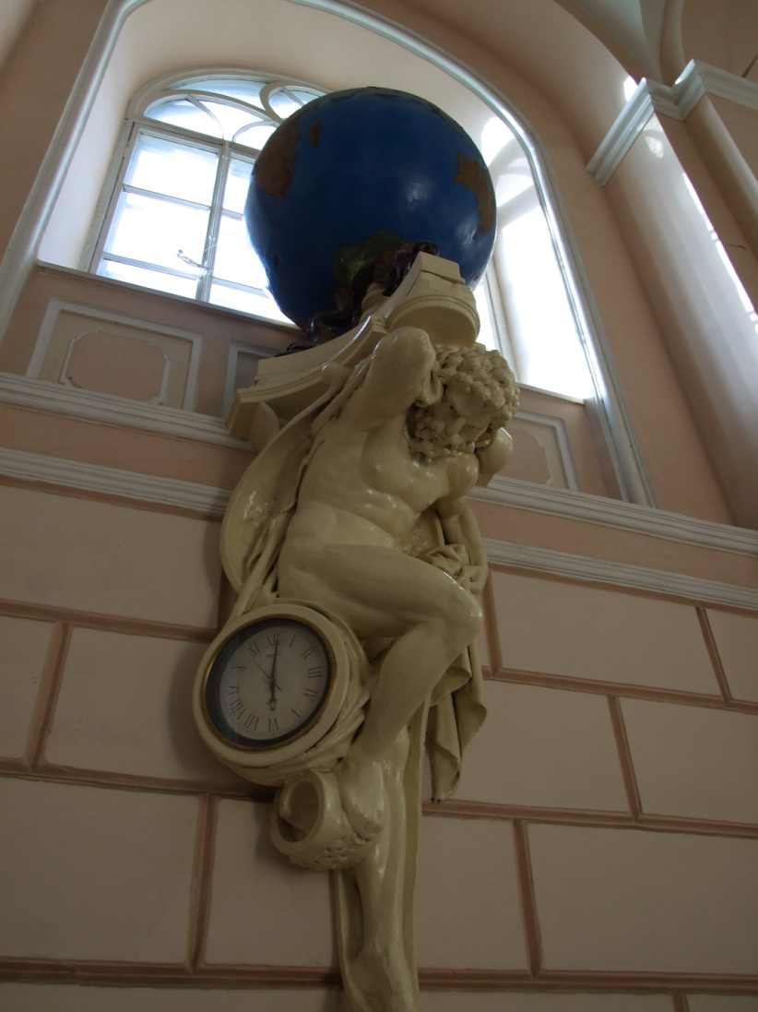
GENERAL INFORMATION Odesa I. I. Mechnikov National University
FACTS and NUMBERS
The University Staff is: 20 Merited Persons in Science and Technique, Education and other branches; 64 persons of Excellence in Education;
10 Laureates of State premiums;
57 members of branch academies and the Corresponding Member of the National Academy of Sciences of Ukraine; 134 Doctors of Sciences, Professors 577 Candidates of Sciences, (PhD) Associate professors.
7 thousand students are currently studying at the University, amongst them – 350 overseas students from 40 countries.
Currently the University Science is: 28 scientific research departments, 14 scientific problems and branch laboratories, 7 scientific centres, 5 research institutes.
Students obtain qualifications in 40 main specialities and specializations at 11 faculties, at Pre-University Education Subdivisions.
Status and License
Accreditation Level – IV
Degrees:
Bachelor of Arts and Science
Master of Arts and Science
Philosophy Doctor
Doctor of Science
Type of Property : State
WWW.ONU.EDU.UA 3

Slide 6
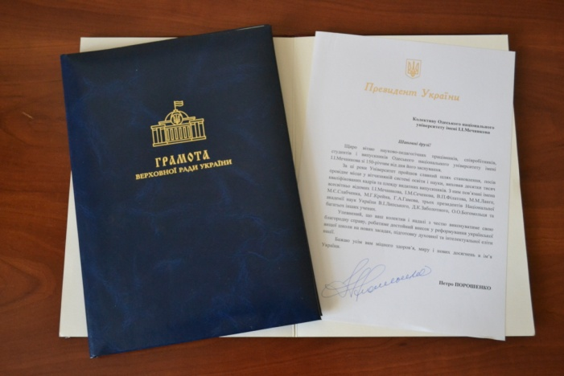
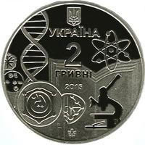
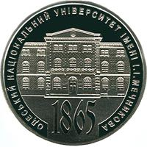
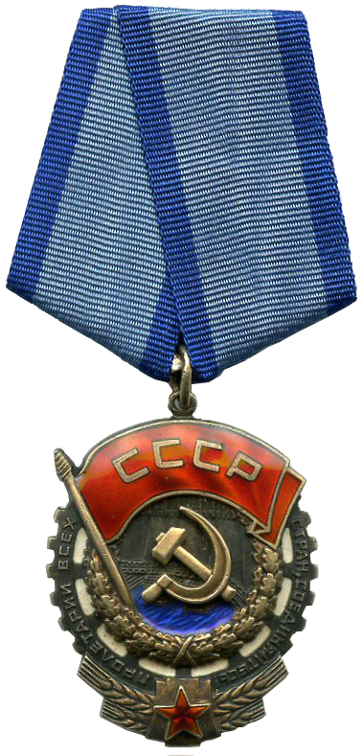
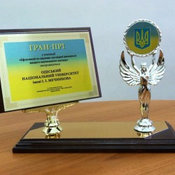
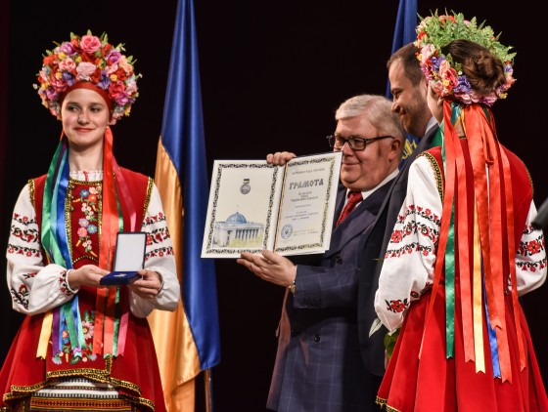
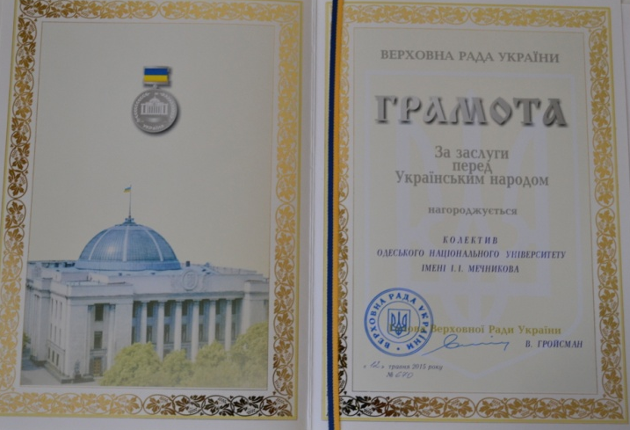
GENERAL INFORMATION Odesa I. I. Mechnikov National University
On May 13, 2020
Odesa I. I. Mechnikov National University solemnly celebrates 155th Anniversary since its foundation.
4 Odesa I. I. MECHNIKOV NATIONAL UNIVERSITY

Slide 7
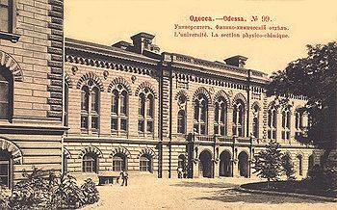
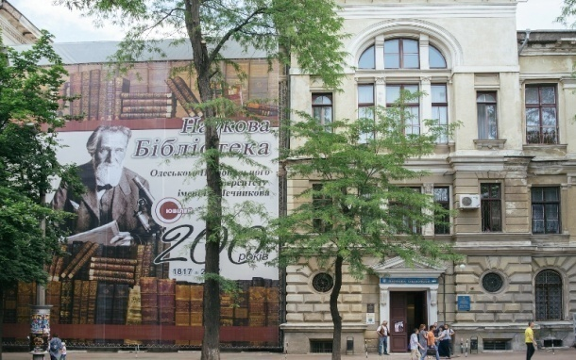
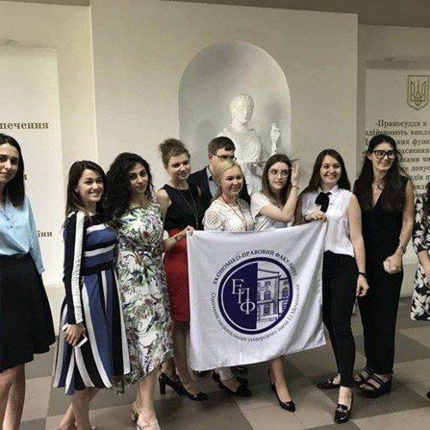
UNIVERSITY DIVISIONS
NUMBERS
The number of Employees
2 223:
Lecturers – 807,
Scientists – 354,
educational and administrative staff - 1062
The number of Students
7 000
Faculties:
Biology
Chemistry & Pharmacy
Economics and Law
Geology & Geography
History and Philosophy
International Relations, Political Sciences and Sociology
Journalism, Advertisement & Publishing
Mathematics, Physics and Information Technologies
Philology
Psychology and Social Work
Romance & Germanic Philology
College of Economics & Social Work
Pre-University Education Subdivisions
Preparatory Department for International Students
Preparatory Department for Ukrainians
WWW.ONU.EDU.UA 5

Slide 8
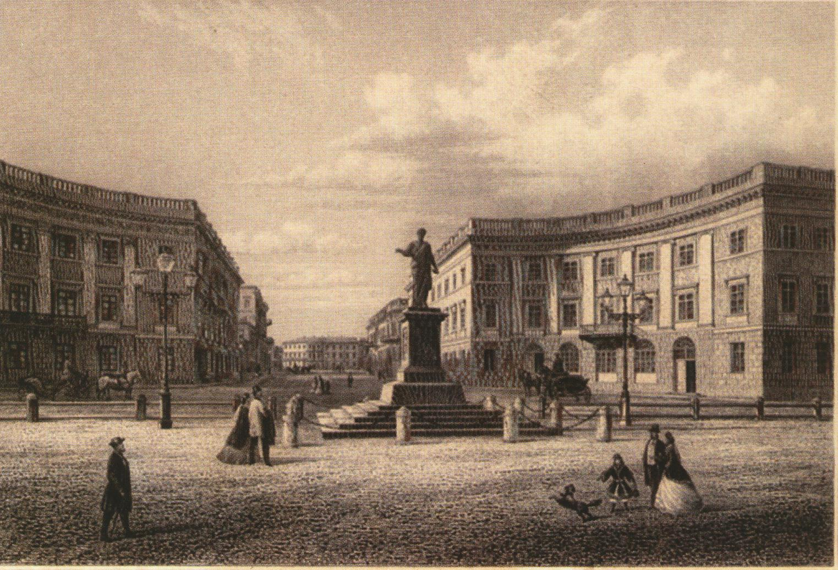
PART 1. Odesa
The location of the University largely determines the educational standards, creates the right mood for studying, and also gives it the Odesa local flavour.
The University is
located in the largest
Black Sea city - Odesa, which is an important cultural, scientific, recreational and industrial centre.
«There is the city which I see in my dreams…»
Two centuries ago, the construction of a port on the Odessa bay began in 1794, which gave impetus to the rapid development of the city.
The history of Odessa was shaped by representatives of many nationalities. Here, in the center of the modern city, were located Greek and Italian colonies, Lithuanian and Tartar castles, the Turkish city of Khadzhibey.
The modern unique face of Odessa was formed during its heyday - in the XIX – the beginning of the XX centuries. Prominent local architects and architects from Austria, Italy, Poland, Germany and other countries transformed the steppe spaces into a modern European city with wide boulevards, spacious theaters, strict administrative and magnificent palace buildings.
Odessa in the twenty first century preserves the image of a wonderful and even mythical city of general prosperity and optimistic mood. It is recognized as the capital of humor and a special, unique perception of life.
6 Odesa I. I. MECHNIKOV NATIONAL UNIVERSITY
Notes:
8

Slide 9
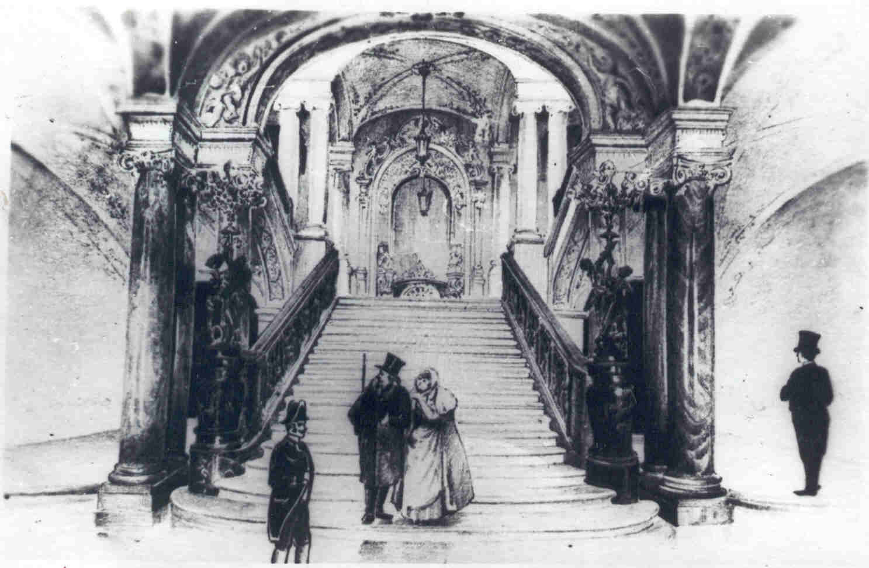
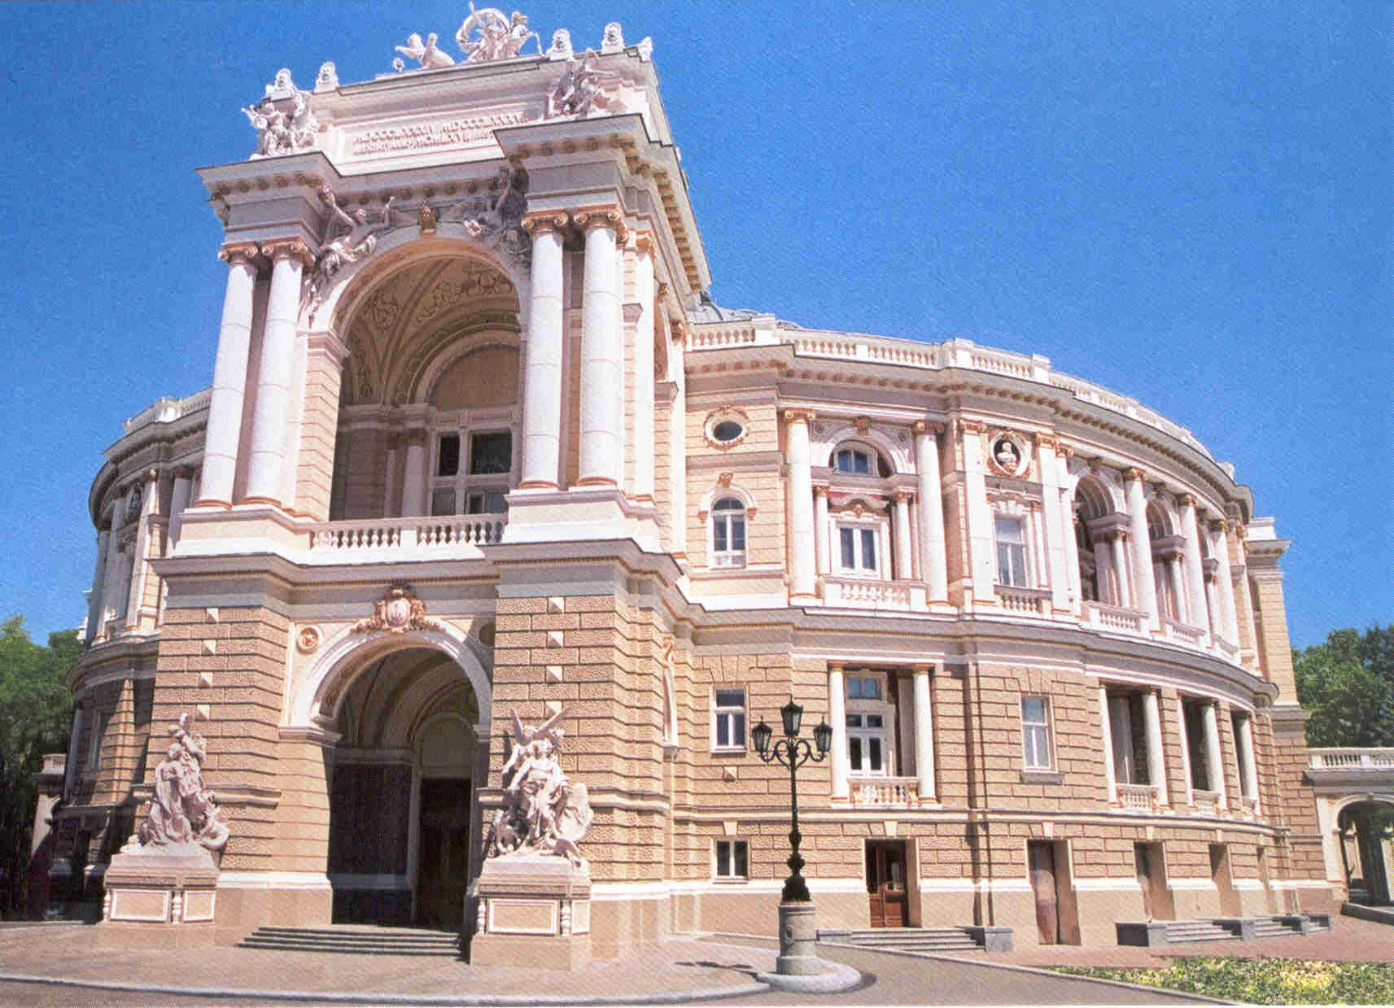
CULTURAL LIFE OF “PEARL OF THE BLACK SEA”
As the economic capital of the Southern Ukraine, Odessa has attracted the attention of not only businessmen but also of artists. One of the first Opera Houses in Eastern Europe was opened here, and the oldest museum in Ukraine.
Famous poets and writers, artists, sculptors lived and worked in the city - O. Pushkin, M. Gogol, L. Ukrainka, I. Bunin, J. Babel, K. Paustovsky, V. (Zeev) Zhabotinsky, K. Kostandi, I. .Aivazovsky, B. Edwards and many others.
Representatives of more than a hundred nationalities created a colorful image of the city with diverse culture.
Today, there are ten major theaters, a film studio, and almost 50 museums in Odessa. The city hosts international festivals of music, dance and films.
The most famous cultural events of the city are the International Film Festival, the celebration of the foundation of Odessa, Humorine - the annual festival on the Day of Humor (April 1).
Odessa is the center of diplomatic missions
of different levels: Consulates General,
Centers of culture, etc.
WWW.ONU.EDU.UA 7

Slide 10
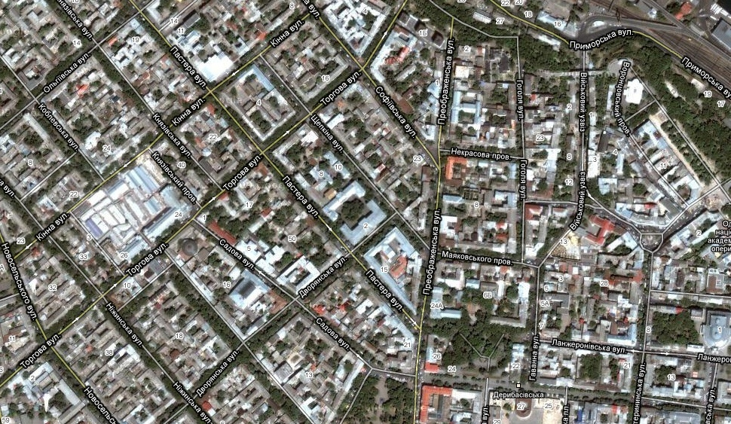
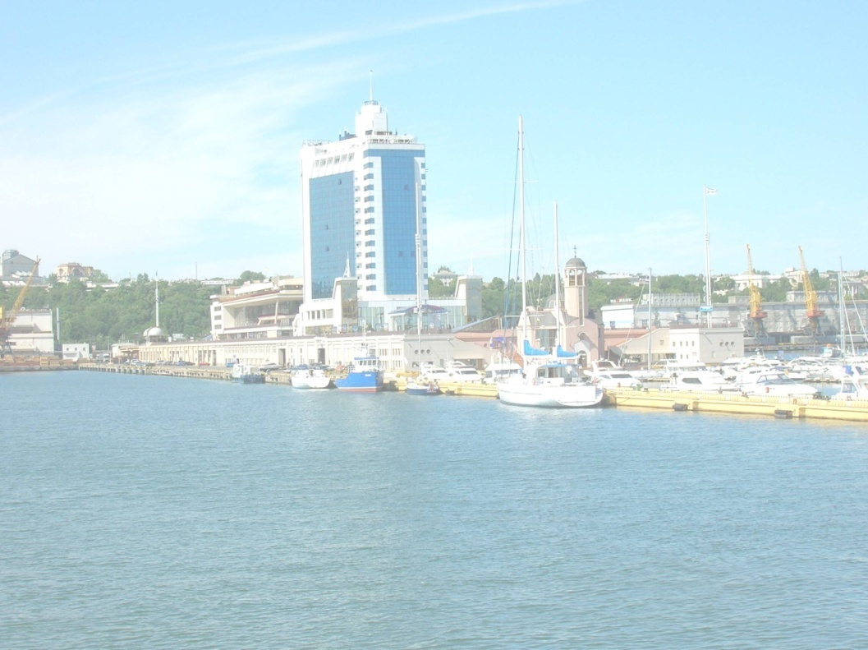
INFRASTRUCTURE
Odessa has well-developed infrastructure with the population of over one million people. It is the largest city on the Black Sea coast of Ukraine which stretches from north to south for forty kilometers - The city agglomeration faces the sea.
The city includes: an international airport, international sea port, bus and railway stations, public transport network, high-level medical establishments, as well as higher education establishments, branches of the National Academy of Sciences and sectoral Academies, centers of culture and recreation.
Odessa is built according the uniform plan, with the streets of a grid system.
The city amazes people with a harmonious combination of man-madeness and naturalness.
HOLIDAYS IN THE UKRAINIAN PALMYRA
Odessa is a resort city. Sea beaches, healing estuary muds and mineral springs attract many holidaymakers here. Hundreds of health resorts, holiday homes, tourist bases are located on the Black Sea coast and salt lakes – estuaries.
The development of the sphere of recreation and entertainment is also one of the advantages of Odessa. Arcadia Resort and Entertainment Center, a large number of clubs and entertainment facilities are open daily to residents of Odessa and to guests of the city.
Bright sunshine, clean air and seawater have made Odessa an important recreation center since its inception
8 Odesa I. I. MECHNIKOV NATIONAL UNIVERSITY

Slide 11
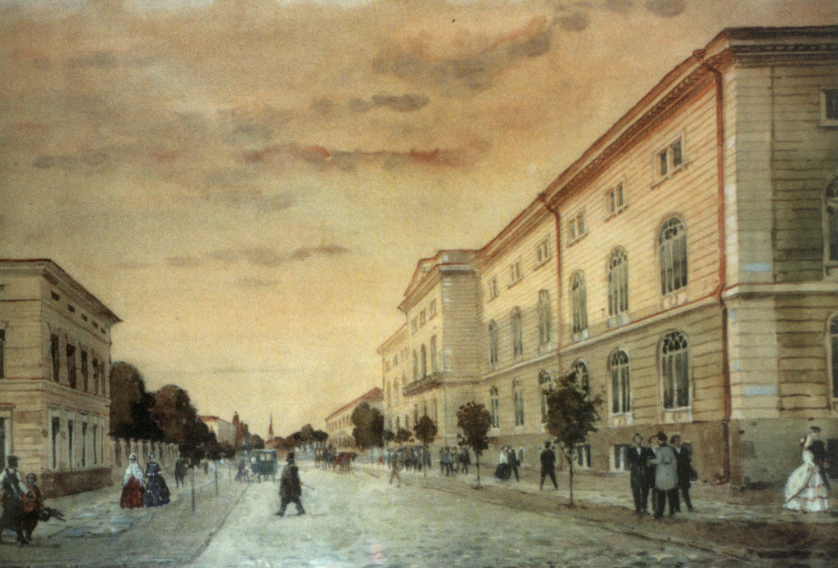
PART 2. UNIVERSITY:
History, Distinguished Scientists and Graduates
Emperor’s Novorossiya University was the first Higher Education institution in the South of the country.
Odessa II Mechnikov National University (ONU), since its foundation on May 1, 1865, and up till now has one of the leading places in the formation of the educational system, in the development of scientific research and culture in Ukraine.
It is one of the oldest universities in Ukraine. Together with the Kiev, Kharkiv and Lviv universities it actually defines the state and prospects of development of education, science and culture of the state.
ONU is a world known university with high international prestige. According to the World Scientific metric database SCOPUS, published by V. Vernadsky Scientific Library, Odessa II Mechnikov National University is in the TOP-5 rating.
Since 2000, the Odessa University has had the status of NATIONAL - it is the highest status of a Higher Educational Establishments in Ukraine.
WWW.ONU.EDU.UA 9

Slide 12
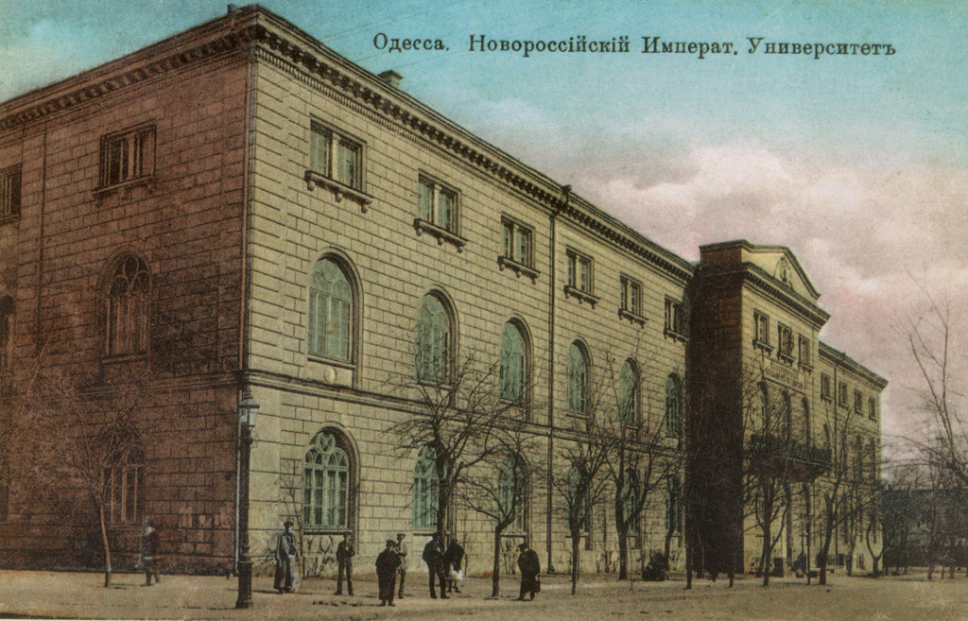
THE HISTORY OF THE UNIVERSITY
In 1817, the first secondary educational institution was opened in Odessa - the Richelieu Lyceum, named in honour of the person who initiated its foundation - Duke Arman-Emmanuel de Richelieu.
In 1857, the Richelieu Lyceum was expanded and it occupied the building which is now the main campus of modern ONU. Among the lyceum teachers were the outstanding scientists - chemist D. Mendeleyev, medical doctor M.Pirogov.
On May 1, 1865 the Russian Emperor Alexander ІІ signed the Decree establishing the Novorossiya University in Odesa.
10 Odesa I. I. MECHNIKOV NATIONAL UNIVERSITY

Slide 13
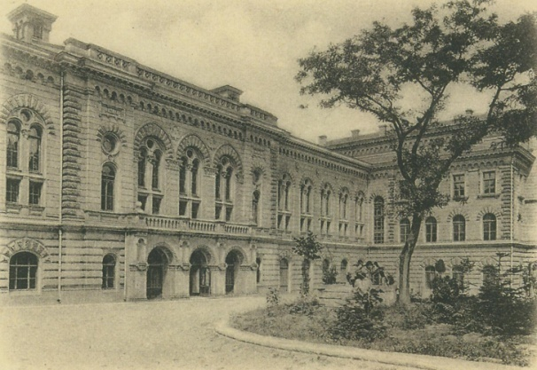
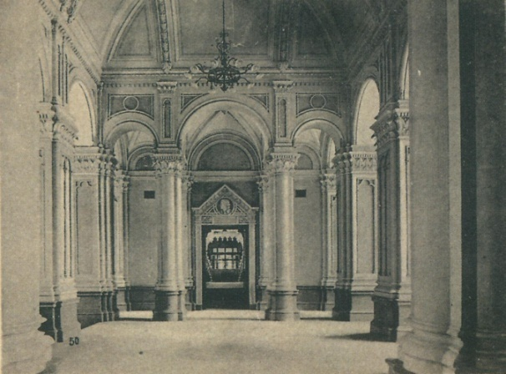
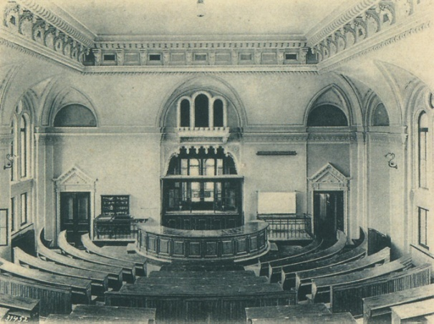
THE HISTORY OF THE UNIVERSTIY
In 1865 the Lyceum was transformed into the University. Three faculties were created:
- Law;
- History & Philology;
- Physics & Mathematics.
In 1920-1933, during the period of educational reforms in Ukraine, the university was temporarily divided: Medical, Polytechnic, Pedagogical institutes (now - universities), later - other higher educational establishments of the city, were created on its base.
In 1934, the university was re-established, and in 1945 it was named in honour of the prominent scientist, Nobel Laureate Illya Ilyich MECHNIKOV.
For the outstanding achievements in specialists training in 1965 Odessa I.I. Mechnikov State University was awarded the Order of the Red Banner of Labour, and in 1978 it was listed as one of the leading universities of the USSR.
In 2000, the University was awarded the Honorary Certificate of the Cabinet of Ministers of Ukraine.
WWW.ONU.EDU.UA 11

Slide 14
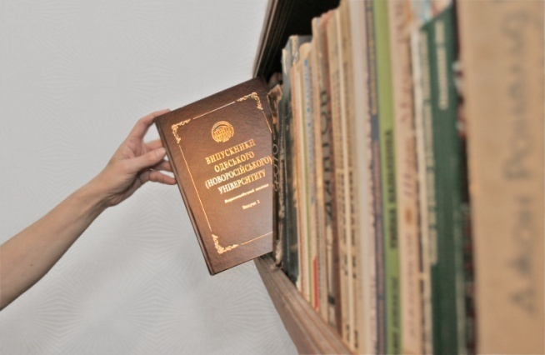
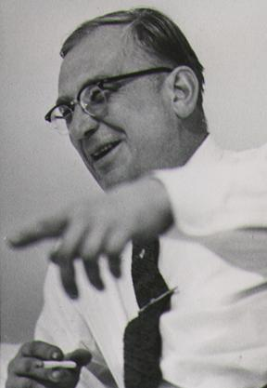
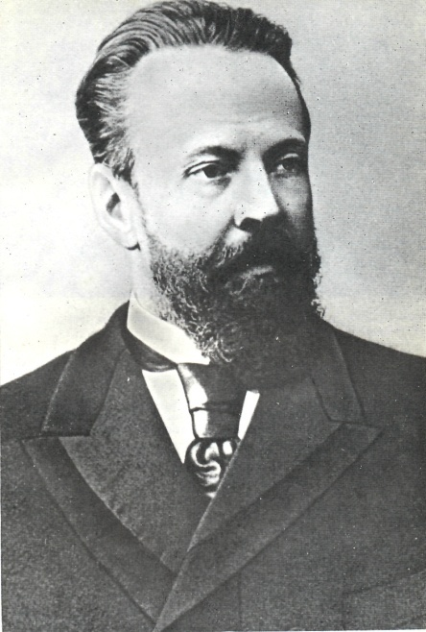
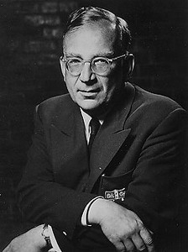
OUTSTANDING GRADUATES AND LECTURERS
The best indicator of teaching quality of the University is the professional level of its lecturers as well as the achievements of its graduates.
BOGATSKY Oleksiy Vsevolodovich (1929-1983) - academician, member of the Presidium of National Academy of Sciences of Ukraine (NAS), founder of the of Physics and Chemistry Institute NAS of Ukraine, Rector of Odessa I.I. Mechnikov State University (1970-1975).
BOGOMOLETS Oleksandr Oleksandrovych (1881-1946) - pathophysiologist and public figure, academician, President of the Academy of Sciences of Ukraine, academician (1930-1946) and Vice-president of the USSR Academy of Sciences and Academy of Medical Sciences USSR (1944).
VERESCHAGIN Leonid Fedorovich
(1909-1977) - physicist and chemist, discoverer of scientific principles and head of the project dealing with the creation of industrial production of synthetic super hard materials - diamond and cubic boron nitride, the Hero of Socialist Labour.
VITTE Sergiy Yuliyovych (1849-1915) - Candidate of Physical and Mathematical Sciences, statesman, Minister of Finance, Chairman of the Russian Empire’s Council of Ministers.
GAMOV Georgy Antonovich (1904-1968) - author of the theory of formation of chemical elements, according to which the whole substance originally consisted of neutrons. He developed the theory of alpha decay through tunneling, worked in the field of radioactive decay of atomic nuclei, nuclear synthesis in the bowels of stars, the Big Bang theory.
The unique four volume edition is dedicated to the outstanding graduates of the University
12 Odesa I. I. MECHNIKOV NATIONAL UNIVERSITY

Slide 15
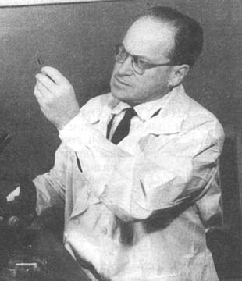
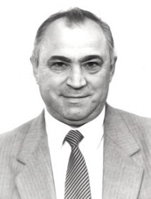
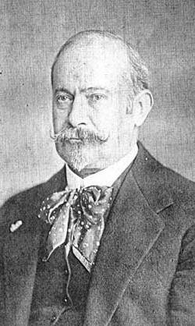
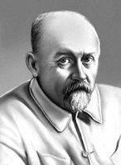
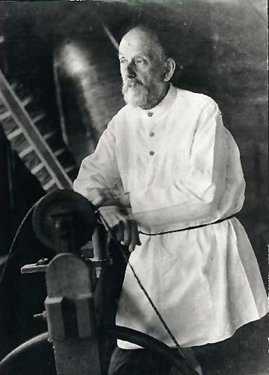
OUTSTANDING GRADUATES AND LECTURERS
GERASYUTA Mykola Fedorovich (1919-1987) - one of the main authors who developed four generations of battle rocket systems (from P-12 to P-36M) and space rocket carriers "Cosmos", "Intercosmos", "Cyclone", "Zenith". Winner of the USSR Lenin and State Prizes, Hero of Socialist Labour, Corresponding Member of the Ukrainian Academy of Sciences.
GRIGOROVYCH Viktor Ivanovich (1815-1876) - Slavologist, one of the first professors of Slavic philology in Russia.
ZABOLOTNYI Daniil Kirillovich
(1866-1929) - microbiologist, Academician and the President of the Academy of Sciences of Ukraine (1929).
ZELINSKY Igor Petrovich (1933-2002) - the outstanding scientist and the founder of scientific school of engineering geology, the author of the theory and engineering development of coastal strengthening. Rector of Odessa I.I. Mechnikov State University (1987-1995). Member of the Supreme Council of the USSR, Member of the Presidium of the Supreme Council of the USSR.
ZELINSKY Nikolay Dmitrovich (1861-1953) - Academician of the USSR Academy of Sciences, the founder of the world-renowned school of organic chemists.
KARPENKO Yuriy Oleksandrovych (1929-2010)
philologist in Slavic linguistics, the leader of the
Ukrainian Onomastic School, Corresponding Member of NAS of Ukraine.
KARYSHKOVSKY Peter Petrovich
(1921-1988) – the Corresponding Member of the German Archeological Institute, historian, numismatist, scientist - encyclopedist.
LYPSKY Vladimir Ippolitovich
(1863-1937) - botanist, Academician, President of the Academy of Sciences of Ukraine (1922-1928).
LYAPUNOV Alexander Myhailovych
(1857-1918) - mathematician who created the theory of stability. Academician of the St.Petersburg Academy of Sciences, Professor.
WWW.ONU.EDU.UA 13

Slide 16
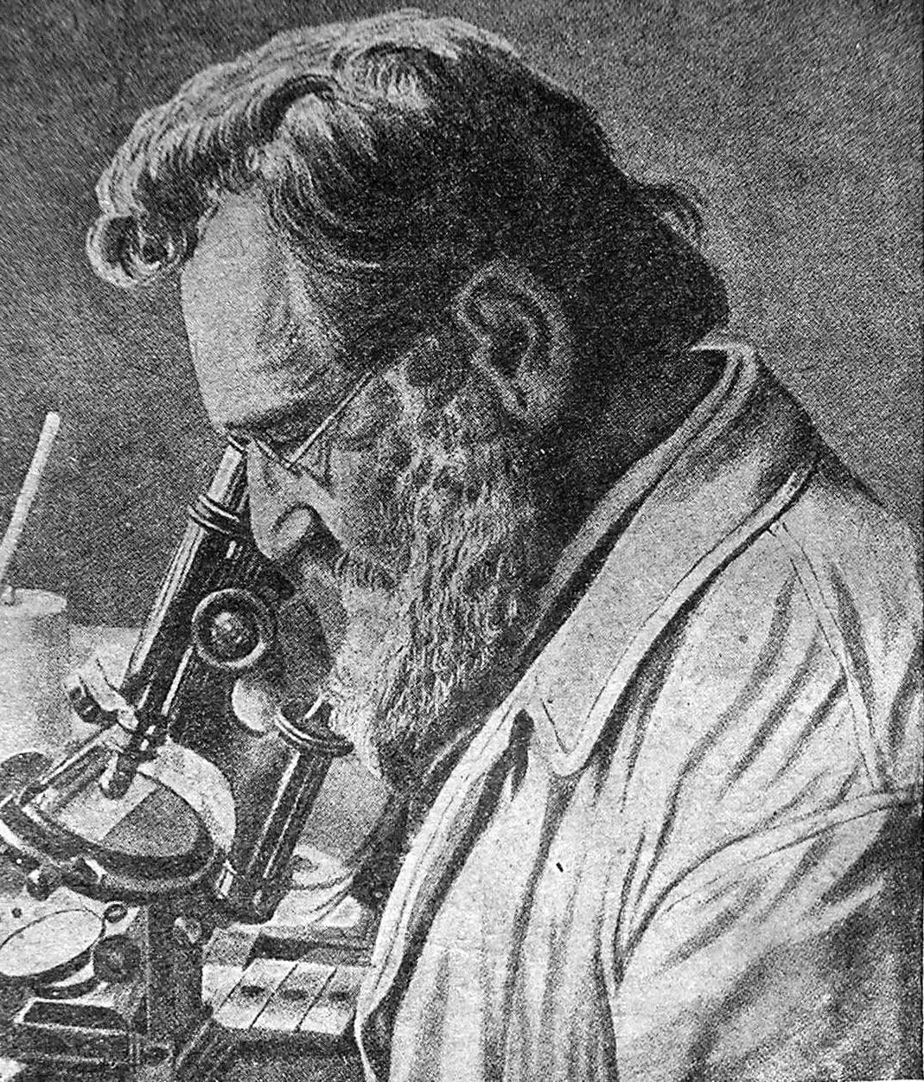
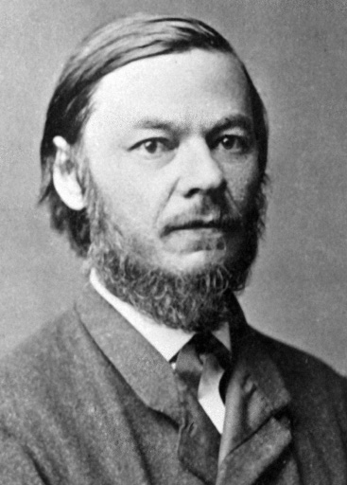
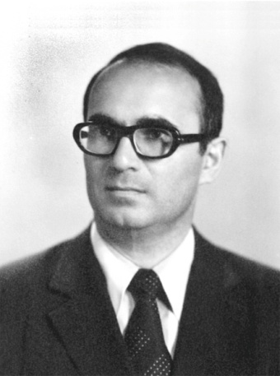
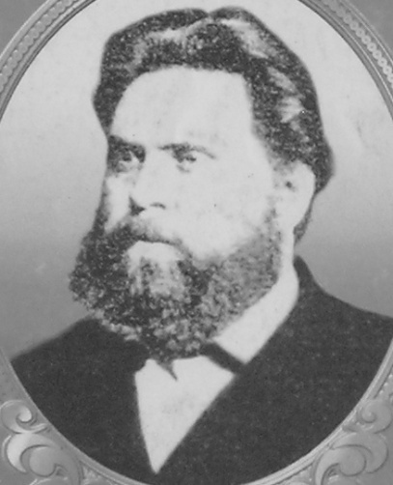
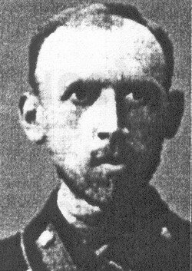
ВИДАТНІ ВИПУСКНИКИ ТА ВИКЛАДАЧІ
MECHNIKOV Ilya Illych (1845-1916) - Nobel Prize Winner, one of the founders of immunology.
PODVYSOTSKY Vladimir Valerianovich (1875-1913) - one of the founedrs of the National medical school, the organizer of the Odessa clinic of children's diseases.
SECHENOV Ivan Mikhailovich (1829-1905) - physiologist. The Corresponding Member of St.Petersburg Academy of Sciences.
SERDYUK Viktor Vasilievich (1934-1994) – the outstanding scientist in the field of physics of semiconductors, founder of the scientific school of physics of semiconductors and semiconductor devices, Rector of Odessa I.I. Mechnikov State University (1975-1987).
SLABCHENKO Mykhaylo Yeliseyevich
(1882-1952) - Ukrainian scientist, historian, academician of the All-Ukrainian Academy of Sciences.
TRETYAKOV Dmitry Konstantinovich
(1878-1950) - zoologist-morphologist, academician of the Academy of Sciences of the USSR.
USPENSKIY Fedor Ivanovich (1845-1928) - Academician of the Russian Academy of Sciences and Academy of Sciences of the USSR, historian and archeologist, Author of the History of Byzantine Empire.
FRUMKIN Alexander Naumovich
(1895-1976) - Soviet physicist, the founder of the electrochemical school, academician of the USSR Academy of Sciences, Hero of Socialist Labor.
KHAVKIN Vladimir Aronovich
(1860-1930) - world-renowned bacteriologist, immunologist and epidemiologist, the first creator the vaccines against plague and cholera, Savior of the world from plague and cholera.
SHVEDOV Fedir Nikiforovich (1840-1925) - physicist, Professor, Dean of the Faculty of Physics and Mathematics, Rector of Novorossiya University.
14 Odesa I. I. MECHNIKOV NATIONAL UNIVERSITY

Slide 17
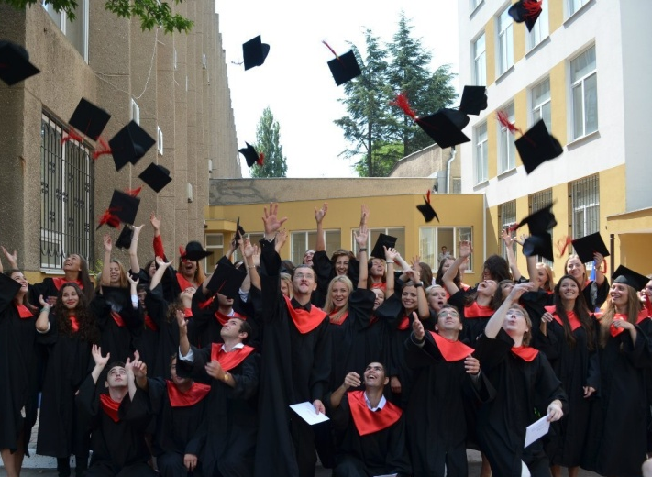
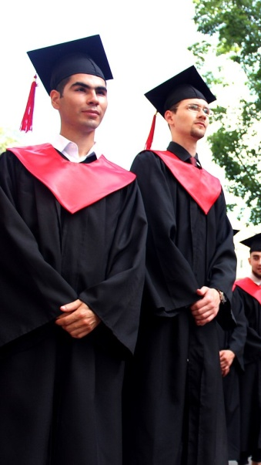
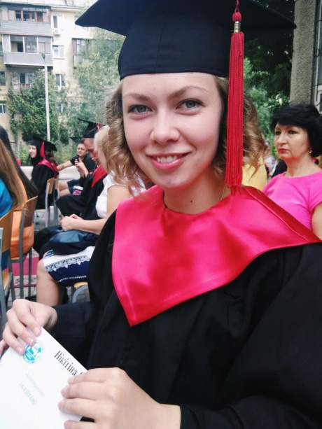
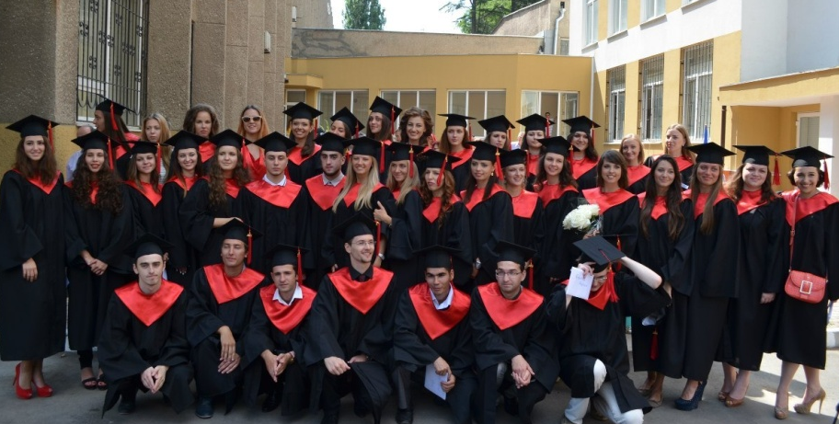
PART 3. EDUCATION
Odesa I. I. Mechnikov National University is the Modern advanced educational complex in Southern Ukraine.
WWW.ONU.EDU.UA 15

Slide 18
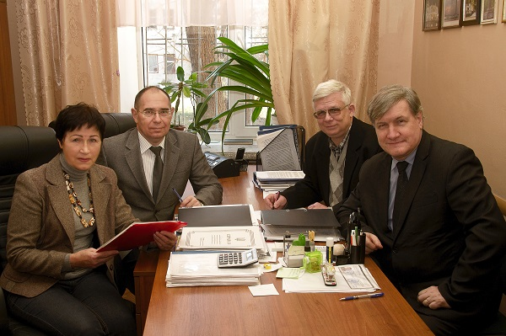
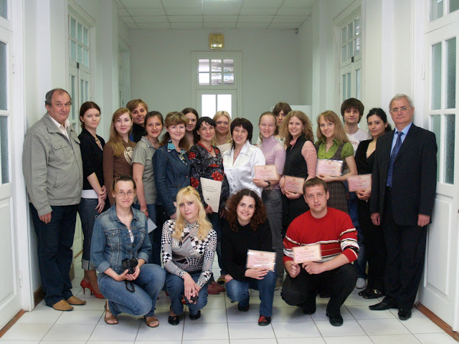
FACULTIES
Faculty of Biology
The Faculty is well known by its complex studies of biological diversity of the South and West of Ukraine. Ecological, genetic, molecular-biological, microbiological, biochemical and physiological studies are also conducted. Zoological Museum, Botanical Garden, Hydrobiological Station are educational and experimental bases of the Faculty . The Scientific Society of Students, Graduate Students and Young Scientists function at the Faculty and regularly held International conferences "Biodiversity. Ecology. Evolution. Adaptation“. October is traditionally joyfully celebrated as a Freshman Day.
Departments :
1. Department of Human and Animal Physiology
2. Department of Hydrobiology and General Ecology
3. Department of Genetics and Molecular Biology
4. Department of Human Health and Civil Safety
5. Department of Zoology
6. Department of Microbiology, Virology and Biotechnology
7. Department of Botany
8. Department of Biochemistry
16 Odesa I. I. MECHNIKOV NATIONAL UNIVERSITY

Slide 19
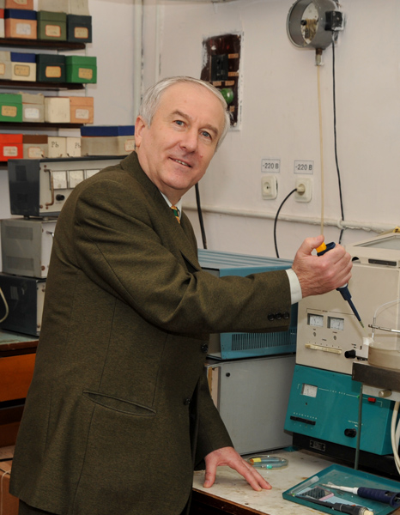
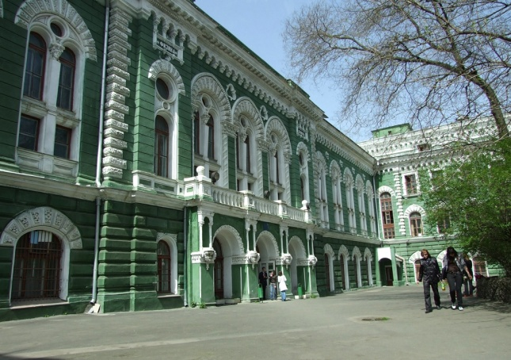
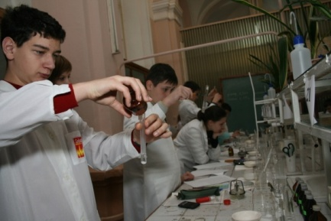
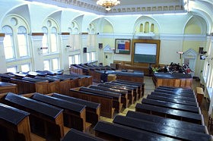
FACULTIES
Faculty of Chemistry & Pharmacy
The Faculty functions in the framework of the unified scientific-production chemical-pharmaceutical complex of the Ministry of Education and Science and the National Academy of Sciences of Ukraine. This makes it possible to use the scientific and practical base of the Bogatsky Physico-chemical Institute in the preparation of future specialists.
The Chemists' Day is celebrated at the end of May. Traditionally, sports and intellectual competitions are held on this day with teachers’ and students’ participation.
Departments :
1. Department of Physical and Colloidal Chemistry
2. Department of Analytical and Toxicological Chemistry
3. Department of Inorganic Chemistry and Chemical Ecology
4. Department of General Chemistry and Polymers
5. Department of Organic and
Pharmaceutical Chemistry
6. Department of Pharmacology and Drugs Technology
WWW.ONU.EDU.UA 17

Slide 20
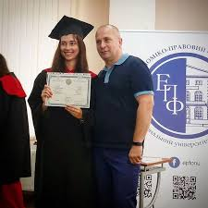
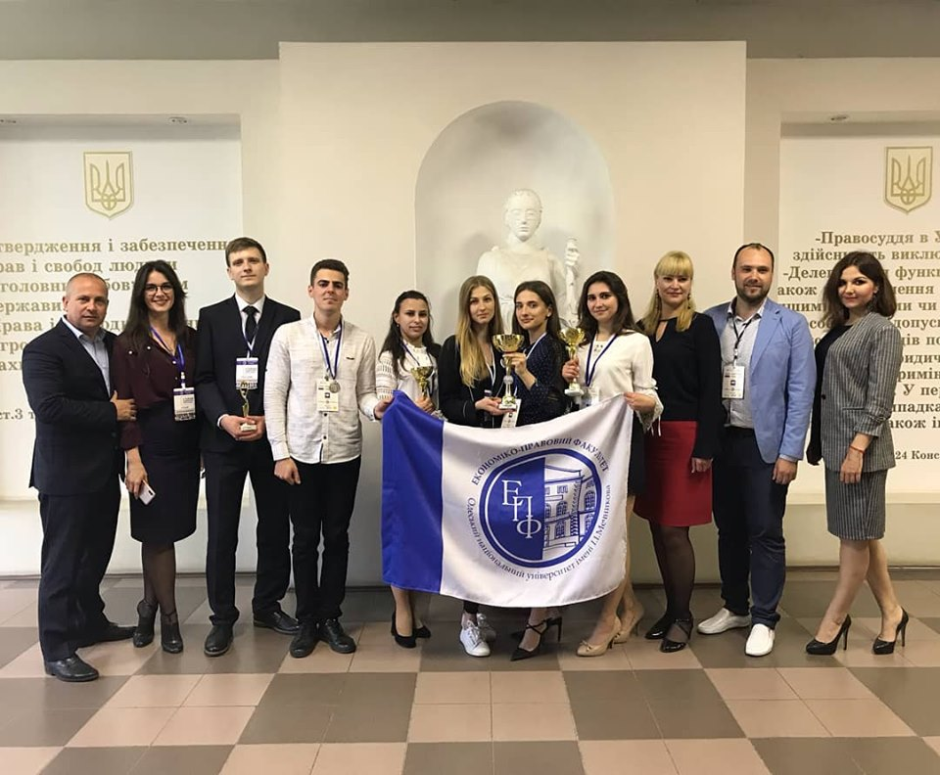
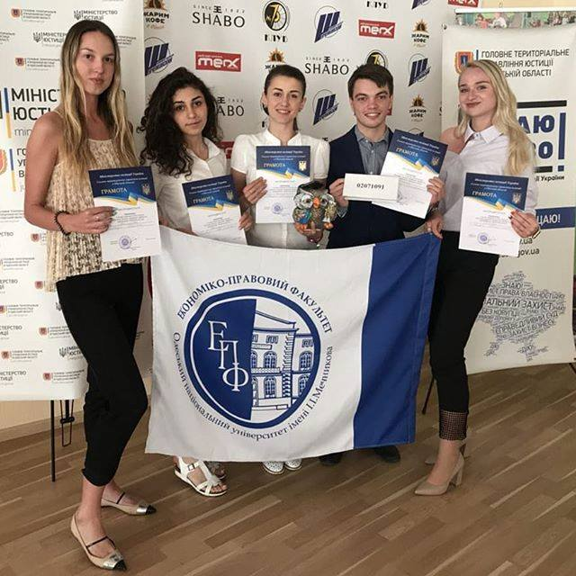
FACULTIES
Faculty of Economics & Law
The Faculty is widely known due to its close links with universities in Germany, Netherlands, USA, Canada and France. It is actively involved in the implementation of the joint European TEMPUS project. The Faculty of Economics and Law publishes the scientific journal “Constitutional State” and the collection of scientific papers “Market Economy: Theory and Practice of Management”.
Departments:
1. Department of General Law and International Law
2. Chair of Criminal Law, Criminal Procedure and Criminalistics
3. Department of Administrative and Business Law
4. Department of Civil Law Disciplines
5. Department of Constitutional Law and Justice
6. Department of Economics and Entrepreneurship
7. Department of Accounting and Taxation
8. Department of Management and Innovation
9. Department of Marketing and Business Administration
10. Department of Finance, Banking and Insurance
18 Odesa I. I. MECHNIKOV NATIONAL UNIVERSITY

Slide 21
FACULTIES
Faculty of Geology & Geography
Scientific developments of the Faculty are addressed to the practical problems and needs of the region and the State in the field of geography, geology and nature management. The faculty has recently opened a new specialty in the field of tourism, which opens significant prospects in the modern labor market. Approximately 25% of the educational process at the Faculty of Geology and Geography is field, educational and industrial practices.
The Faculty celebrates its annual Faculty Day on the first Saturday of April. Faculty athletes, and in particular, boxers, in recent years have won prizes at competitions of different levels: city, regional, all-Ukrainian and international ones.
Departments:
1. Department of Physical Geography and Natural Resources Management
2. Department of Economic, Social Geography and Tourism
3.Department of Geography of Ukraine, Geography of Soils and
Land Cadastre
4. Department of Geological Engineering and Hydrogeology
5. Department of General and Marine Geology
6. Department of Physical Education and Sports
WWW.ONU.EDU.UA 19

Slide 22
FACULTIES
Faculty of History & Philosophy
Trains bachelors and masters in the fields of history and archeology, philosophy, and cultural studies. Cooperation with the museums of Ukraine, higher educational institutions of Italy, Germany, Poland, Romania facilitates the training of historians with the knowledge and skills of field archeology, ethnology, archival affairs, art studies. The Archeology and Ethnography Laboratory of the Steppe Ukraine, Folklore and Ethnographic Studio “Dzherelo” provide opportunities for reconstruction and popularization of the material and spiritual heritage of the region's population.
Departments:
1. Department of Archeology and Ethnology of Ukraine
2. Department of History of Ukraine
3. Department of World History
4. Department of Culturology
5. Department of Philosophy
20 Odesa I. I. MECHNIKOV NATIONAL UNIVERSITY

Slide 23
FACULTIES
Faculty of International Relations, Political Science & Sociology
The Faculty is well known in Ukraine and abroad. The students of the faculty take their professional practice in diplomatic institutions of the Ministry of Foreign Affairs of Ukraine and linguistic internship at foreign higher educational establishments, participate in international conferences. Students of the Faculty bring awards from the students’ all-Ukrainian Olympiads. Special centers for Turkish, Greek, Chinese and Japanese languages ​​and cultures, a Center for International Studies, and a Center for the Non-Proliferation of Nuclear Weapons function at the Faculty.
The Faculty’s birthday is traditionally celebrated on the first Friday of December. Traditionally, an inter-departmental scientific conference and a solemn concert are held on this day.
SPECIALITIES:
- Political sciences
- Sociology
- International relations, Public communications and Regional studies
- International Economic Relations
Departments:
1. Department of International Relations
2. Department of Political Sciences
3. Department of World Economy and International Economic Relations
4. Department of Sociology
5. Department of History and World Policy
WWW.ONU.EDU.UA 21

Slide 24
FACULTIES
Faculty of Journalism, Advertising & Publishing
The active development of communication technologies ensures a constant increase in the demand for publishing and editing specialists in the international labour market. Participation in the European Union project “Cross-media and quality journalism” involves providing ONU with state-of-the-art equipment and new technologies for training students and teachers. The Faculty publishes 15 professional newspapers and the TV studio facilitates professional abilities.
Departments:
1. Department of Periodical Press and Editing in Media
2. Department of New Media and Media Design
3. Department of Journalism, Advertising and Media Communications
22 Odesa I. I. MECHNIKOV NATIONAL UNIVERSITY

Slide 25
FACULTIES
Faculty of Mathematics, Physics & Information Technology
The Faculty provides its graduates with competitive conditions in the modern labour market. This is executed by the following specialties:
Maths;
Applied Mathematics and Information Technology;
Physics and Astronomy;
Applied Physics and Nanomaterials;
An information technology laboratory (5 computer classes) is equipped for the educational process. Students of the faculty are active in many international competitions and students’ competitions. Faculty conducts research in the field of physics and astronomy. The Faculty has a Specialized Scientific Council for dissertations in physics and astronomy.
Departments:
1. Department of Higher Mathematics
2. Department of Mathematical Support for Software Computer Systems
3. Department of Mathematical and Computer Modeling
4. Department of Differential Equations, Geometry and Topology
5. Department of Computer Algebra and Discrete Mathematics
6. Department of Mathematical Analysis
7. Department of Optimal Control and Economic Cybernetics
8. Department of Theoretical Mechanics
9. Department of Methods of Mathematical Physics
10. Department of System Software and Technologies of Distance Learning
11. Department of Experimental Physics
12. Department of General Physics and Physics of Thermal Power and Chemical Processes
13. Department of Theoretical Physics and Astronomy
WWW.ONU.EDU.UA 23

Slide 26
FACULTIES
Faculty of Philology
The Faculty of Philology has existed since the founding of the university and currently is a powerful source of qualified personnel.
The Faculty prepares qualified specialists in the field of Ukrainian, Russian and other Slavic philologies (Polish, Bulgarian, Serbian, etc.).
The Faculty publishes 7 scientific journals and collections.
International, regional and students’ scientific conferences are regularly held. The Faculty also has close links with the Bulgarian and Polish consulates, providing regular linguistic practice for students.
The Faculty of Philology effectively cooperates with many foreign universities and
is actively involved in the "Horison 2020" and "Erasmus" programs. The Faculty professional Holiday is celebrated at the beginning of April.
Departments:
1. Department of Ukrainian Language
2. Department of Ukrainian Literature
3. Department of Applied Linguistics
4. Department of World Literature
5. Department of Literary Theory and Comparativistics
6. Department of Russian Language
7. Department of General and Slavic Linguistics
24 Odesa I. I. MECHNIKOV NATIONAL UNIVERSITY

Slide 27
FACULTIES
Faculty of Psychology & Social Work
In the modern society the specialists trained by the Faculty are in great demand.
On the basis of its laboratories both the psycho-diagnostic tools are developed, and their methodological and theoretical substantiation and validity are carried out. Students have computer classes, a modern library, all necessary facilities for effective training.
Departments:
1. Department of Social Theories
2. Department of Social Care
and Practical Psychology
3. Department of General Psychology and Psychology of Personal Development
4. Department of Clinical Psychology
5. Department of Differential and Special Psychology
6. Department of Social and Applied Psychology
7. Department of Social Work
WWW.ONU.EDU.UA 25

Slide 28
FACULTIES
Faculty of Romance-Germanic Philology
Intensive business activity in a country attracts a significant number of foreign partners, strengthens contacts with foreign specialists, determines the high demand for graduates of the Faculty. Foreign languages are taught by native speakers of English, German, Italian and Greek languages. Students may realize their creative abilities in the traditional autumn concert of amateur art "Freshman's Day", on the days of classes, phonetic courses, theatrical performances, Evening Parties at the Youth Center, sports competitions. The resource Centres of Germany, Spain, Greece, France, Italy, together with the art centre, the conferences translators class function at the Faculty.
Departments:
1. Department of French Philology
2. Department of Foreign Literature
3. Department of Foreign Languages of Humanities Faculties
4. Department of Foreign Languages for Natural Sciences Faculties
5. Department of Spanish Philology
6. Department of Theoretical and Applied English Phonetics
7. Department of English Grammar
8. Department of English Lexicology and Stylistics
9. Department of German Philology
10. Department of Pedagogy
11. Department of Theory and Practice of Translation
26 Odesa I. I. MECHNIKOV NATIONAL UNIVERSITY

Slide 29
PRE-UNIVERSITY EDUCATION SUBDIVISIONS
Pre-University Department
(for citizens of Ukraine)
The Faculty of Pre-University training was established in 1998, instead of the Preparatory Courses which existed in the Richelieu Lyceum. The Faculty was renamed in 2013 to Pre-University training department.
The main tasks of pre-university preparation are to deepen, systematize and consolidate the knowledge of entrants in the complexes of subjects; practical preparation for the test completion in order to successfully pass the independent external evaluation and admission to the Mechnikov ONU, or other institutions of higher education in Ukraine.
The education is based both on full-time and part-time forms of study.
The students training in the departments of courses is carried out according to the programs of school disciplines.
Teachers of the University who are familiar with modern teaching methods are involved in working with the students.
PUD working Address: Odessa, 24/26 French Boulevard, office. 82 –A;
phones: 63-76-04; (067) 49-11-214; e-mail fdp@onu.edu.ua
Preparatory department for international students –
see p. 33
College of Economics & Social Work
The Economics and Social Work College is a structural unit of the university, where junior specialists are trained.
The history of the College begins with the creation of the educational-scientific complex "School-College-University" of the Odessa I.I. Mechnikov State University in 1998. The Author University team of scientists and professors organized it due to the Order of the Ministry of Education and Science of Ukraine and by the Support of the Odessa Regional State Administration.
Doctors of sciences, candidates of sciences, teachers of the highest category work on 5 cycle commisions. The high level and quality of education at the college is ensured by engaging the teaching staff of the departments of the faculties of the Odesa I.I. Mechnikov National University. The College also cooperates with all academic units of the University for the theoretical and practical preparation of students.
According to the license of the Ministry of Education and Science of Ukraine, the College provides training of specialists of educational qualification level "junior specialist" in the following specialities:
Applied Mathematics,
Social work,
Finance, banking and insurance,
Accounting and taxation.
During its existence, the college has trained more than 3000 specialists in the prestigious specialities for the contemporary labour market.
College graduates who wish to continue the studies in the chosen speciality are enrolled in the university's advanced courses to obtain a basic higher education in full-time or part-time education.
WWW.ONU.EDU.UA 27

Slide 30
PART 4. RESEARCH AND SCIENCE
Scientific research is concentrated in 30 scientific departments, amongst which there are 3 Scientific Research Institutes, 10 Scientific Research Centres and 16 Scientific Research Laboratories.
The University collaborates within cooperation agreements with over 190 higher education establishments and international organisations.
In recent years, scientists and lecturers of the University have published:
- 57 monographs,
in Ukraine - 35;
abroad - 22
- 145 textbooks, manuals
- 2787 articles,
in Ukraine - 2292;
abroad - 495
28 Odesa I. I. MECHNIKOV NATIONAL UNIVERSITY

Slide 31
SCIENTIFIC RESEARCH DEPARMENTS
One of the main priorities of Odesa
I.I. Mechnikov National University is students’ active participation in scientific research.
The efforts of the team of scientists and scientific-pedagogical staff of the University are directed to fulfill the priority R&D directions for the Ukrainian State, which is administered by the Special Research Subdivision, in the structure of which are:
The Scientific Research Institute “Astronomical Observatory” was established in 1871 and now is one of the oldest in Ukraine. The observatory boasts a collection of star sky shoots taken within the 20th century which ranks third in the world and is considered to be national heritage.
The Scientific Research Institute of Physics was the first university scientific institute of physics in Ukraine. It was founded in 1926 and became the famous centre in the area of optical information, which represented Ukraine at the International Committee of Scientific Photography. The Institute’s works have been awarded prizes by the Government of Ukraine, of the former USSR and the American Photography Society.
The Institute of Combustion and non Traditional Technologies (ICnTT) is the only one in Ukraine of its kind. ICnTT represents Ukraine at the European consortium in nano-materials.
The scientific –research works are also conducted in the:
SCIENTIFIC LIBRARY - one of the largest and the oldest University scientific library in Ukraine, which plays an important role in the organization of scientific and educational works. The library carriers out its own research and also effectively contributes to the scientific work of the university. It was founded in 1817 as a Richelieu Lyceum library and has a fund of more than 4 million volumes, including the unique ancient editions of XV-XVIII centuries.
The majority of the students are engaged in solving challenging scientific tasks. Every third student of the University is passionate about scientific work.
The University's scientists take an active part in international conferences and cooperation between higher education establishments.
WWW.ONU.EDU.UA 29
Notes:
h
31

Slide 32
SCIENTIFIC RESEARCH DEPARMENTS
The Botanical Garden is one of the oldest (since 1867) scientific centres of world-wide flora diversity.
It has the status of a Natural Heritage Site and
it has been listed on the Natural Reserve Fund
of Ukraine. The collection includes 3840
species of plants, biological forms and hybrids.
The ex-president of the Ukrainian Academy of Science
V.I. Lipskiy was in charge of the University
Botanical Garden in the period of 1928-1937.
Among the scientific subdivisions are:
The Hydrobiological Station set up in
1902 by the well-known zoologist
P. M. Buchinskiy and is unique
in Ukraine.
Petrograff-Mineralogical Museum -
Established in 1865 is the source of a great
variety of minerals of considerable scientific
and educational value.
The Zoology Museum set up in 1865 and
currently has 50 000 exhibits.
The Paleontology museum founded
in 1873. One of the largest paleontology
collections in Europe is presented in it and
currently has 40 000 exhibits.
Museum of the Rare Book -
established in 1979, it has more than 100,000 rare and valuable books and incunabula. It functions in the structure of the ONU Scientific Library.
The Post Graduate Education Department (PhD) and Doctor of Science Preparation Department (Dr. Sc)
The Post Graduate Department
is one of the largest in Ukraine. It has about
300 PhD students and an average of 15 Dr.Sc. students yearly. In average 10 Dr. Sc. and 30 PhD theses are completed every year.
This activity is facilitated by 11 specialized dissertation Councils for more than 24 specialities.
30 Odesa I. I. MECHNIKOV NATIONAL UNIVERSITY

Slide 33
ЧАСТИНА 5. МІЖНАРОДНА ДІЯЛЬНІСТЬ
PART 5. INTERNATIONAL ACTIVITY
In 2016 the ONU I. I. Mechnikov Rector, Prof. I. M. KOVAL, was awarded with the Diploma of “Doctor Honoris Causa” of Galatz University (Romania)
International Scientific-Educational Collaboration
Odesa University is the only university in Southern Ukraine which is an accredited member of the consortium «Erasmus Mundus – External cooperation window», which allows students, PhD and Dr.Sc. students and lecturers to have long-term work experience in leading Universities of Western Europe.
Odessa I.I. Mechnikov National University is a Member of the European Universities Association, Danube Rectors Conference.
ONU is a highly recognized leader in the Bologna process promotion amongst Ukrainian and overseas students. According to the programme of “harmonising the architecture of the European Higher
Education system” we have students
studying with us from the Universities Ca‘ Foscari (Venice, Italy), Regensburg and
Bremen (Germany), Tsandzyn (China),
Fatikh (Turkey) and many others.
Our University cooperates with 160 widely recognised higher education establishments from all over the world.
The University is engaged in
international programmes: TEMPUS, TACІS,
ІNTAS, KNOW-HOW, “DNIPRO”, CRDF, FP-6,
FP-7, Gorizont 2020. Under the aegis of students’
exchange programmes the University offers great
opportunities for its students, post
graduate students and lecturers. They all
can learn about the peculiarities of
our partners’ education systems through
doing work experience in museums, scientific units
actual teaching practice, attending
seminars and conferences in Italy,
Hungary, Poland, Romania, Bulgaria and
other countries.
WWW.ONU.EDU.UA 31

Slide 34
INSTITUTE OF THE INTERNATIONAL EDUCATION (ININED)
ININED organizes and supervises the provision of educational services to foreign citizens in all specialties accredited in the University:
Bachelor, Master, Ph.D. Student, Dr. Sc. student, educational and scientific training.
ININED organizes and facilitates both foreign and Ukrainian students’ mobility within the Bologna process, studying and training abroad for Ukrainian students.
ININED also provides for foreign citizens (former students) services of their educational documents confirmation given by ONU.
32 Odesa I. I. MECHNIKOV NATIONAL UNIVERSITY

Slide 35
PREPARATORY DEPARTMENT WITHIN ININED
Preparatory department for international students (PDIS) has been existing for 23 years. Over this period of time this structure has prepared over 2650 overseas students from 56 countries for their joining higher education establishments all over Ukraine. The students come from Algeria, Afghanistan, Vietnam, Egypt, Jordan, China, South Korea, Lebanon, Libya, Morocco, Germany, Palestine, Peru, Romania, Syria, Sudan, USA, Tunisia, Turkey, India, Iraq, Iran, Finland, France, Sweden , Japan and many others.
Students may either obtain governmental grants or fund themselves independently.
Initially overseas students obtain an elementary level of Russian/Ukrainian. They may on their will be trained in some basic concepts of the following target subjects: Mathematics, Economics, Physics, Chemistry, Biology, Psychology, Philology, History, Sociology and other sciences for their adaptation to Ukrainian educational standards.
Lecturers and consultants deliver both class and individual programme courses as well as modules of intensive courses in a wide range of disciplines for students from universities of Austria, Poland, Germany, the Netherlands and France. In order to ensure a high quality learning process the PDIS is equipped with computers, linguaphone classes, self-study areas and separate rooms for consultations. All these facilities are located in the city university campus.
Students are provided with accommodation at the university dormitories. They may also have easy access to conference rooms for ethnic and cultural community gatherings.
Overseas students take an active part in the social life of the University; they attend sports classes, drama and arts clubs. The university organizes meetings for the students with famous scientists, artists and public figures. During the winter and summer holidays overseas students can enjoy themselves by attending parties especially arranged for them, going on sightseeing tours around Odesa or short and long trips to other attractive parts of Ukraine: Kiev, Askaniya-Nova, Belgorod-Dnestrovskiy, Uman and other places of interest.
WWW.ONU.EDU.UA 33

Slide 36
PART 6. INFRASTRUCTURE
Totally University operates by 8 educational buildings, which are located both in the historical part of the city centre and in the beachside resort area of Odesa, thus forming a great university’s campus area.
The Social and household base of the university includes eight dormitories, four dining rooms, a hairdresser and other infrastructure facilities with a total area of 40 thousand square meters.
34 Odesa I. I. MECHNIKOV NATIONAL UNIVERSITY

Slide 37
UNIVERSITY BUILDINGS
The main building of the University is located in the former premises of the Richelieu Lyceum, 1852-1857. Its address is: 2, Dvoryanska street.
The Faculty of Mathematics, Physics and Information Technologies and the Faculty of Psychology and Social Work are located at the same building.
The Departments of History and Philosophy, Chemistry, Preparatory Department for international students as well as the Scientific library are situated in the city centre in separate buildings.
The building for humanities, 24/26, French Boulevard, comprises Faculty of International Relations, Political Science and Sociology, Faculty of Economics and Law, Faculty of Philology, Faculty of Romance and Germanic Philology, Faculty of Journalism, Advertisement and Publishing and the Preparatory Department for Ukrainians.
The new building for humanitarian faculties was put into operation in 2014. Its total area is 6700 sq. metres.
Just behind the main humanities building there is another one, with the faculties of Biology and Geology & Geography.
Economics & Social Work College is located at 6, Marshal Govorov Street.
WWW.ONU.EDU.UA 35

Slide 38
CULTURE AND LEISURE CENTRE
STUDENTS & STAFF CULTURE AND LEISURE CENTRE
The center of culture and leisure is a favorite vacation spot for students and teachers of the university. It is the organizer of numerous holidays (Christmas, New Year, etc.), as well as solemn events in the life of individual faculties and the university as a whole.
The center organizes concerts with the participation of famous musicians and artists, contributes to the realization of the creative potential of students and staff.
THE ACADEMIC CHOIR CHAPEL (UKRAINIAN AMATEUR FOLK ARTS GROUP) performs sacred and ancient secular music, classical music and Ukrainian folk songs. The Chapel tours Ukraine and abroad every year.
FOLK DANCE GROUP “UniverDance" takes an active part in rising people’s awareness of Ukrainian folk dancing. The repertoire is based on Ukrainian folklore traditions, but the ensemble is not limited to Ukrainian dances. They have got their repertoire - dances of peoples from all over the world. During its existence, "UniverDance" visited with their vivid performances
Italy, Greece, Spain, Turkey, France
and other countries.
36 Odesa I. I. MECHNIKOV NATIONAL UNIVERSITY

Slide 39
CULTURE AND LEISURE CENTRE
Numerous bands and single performers have been carrying out their creative work at the culture centre. Today there are more than 6 music bands, among which are music band “M. Tusso”, female group “Flowers’ Lady Band” and “Liberty” dance club
in which more than 50
students take part.
Every year new art
collectives appear.
Two ONU graduates –
world champion in step Sergiy
Ostapenko and three-time
champion in step Olexander
Ostanin head the
dance clubs “Nikomo-tap-studio” and “Ostanin-dance-centre” respectively. Their pupils also became world champions in step in 2016.
ONU is the HEI, which has brought up many well-known teams of the Club of Merry and Smart, among which the most famous in the CIS countries are the Gentlemen of Odessa State University. Their traditions today are continued by the team "New Reality", which became the champion of Ukraine, and the team "Trumpet Ladies", which participates in the Odessa Humor Championship in the League of Laughs.
WWW.ONU.EDU.UA 37

Slide 40
SCIENTIFIC PERIODICALS AND
PR-SERVICE
PR-Service
Publishing House “Odessa I.I. Mechnikov National University” produces educational (textbooks, manuals, courses and lecture notes, etc.) and scientific literature (monographs, materials of conferences, scientific periodicals). Among the scientific periodicals are “The Herald of the Odesa National University” (series Biology, Economics, Psychology, Chemistry, etc.); "Microbiology and Biotechnology", "Photoelectronics", etc. In total, more than 100 editions of educational, scientific and advertising literature is published during a year.
On the official site of ONU I.I. Mechnikov www.onu.edu.ua among the general information about ONU, one can get acquainted with the news of the university and current events in its life, which are covered by the Press Service and the Department of International Relations (IRO).
Nearly a quarter of million visitors from 32 world countries constantly read the ONU news and watch interesting photos and videos.
38 Odesa I. I. MECHNIKOV NATIONAL UNIVERSITY

Slide 41
SPORTS
Physical and sports training in ONU Mechnikov is ensured since 1946 by the Department of physical training and sports.
Twenty five trainers and teachers (highly qualified experts in sports training) work at the Department which is headed by O.M. KAZANOVA – Master of Sports of the USSR (art gymnastics).
The physical training and sports occupy the specific place conditioned by the idea that physical culture is an inalienable part of general culture of a human being and is a part of his general education.
The organization of educational work of the Department of Sports has deep traditions which ensure all the students and staff the possibility for sports training since the 1st course of education within different types of sports.
The Odesa I. I. Mechnikov University has contemporary well equipped sports base which comprises stadium and play grounds with the training equipment, 3 tennis courts, 10 sports play-grounds, 7 houses for physical recreation training and great playhall.
Nearly 5000 students may be trained at 3 different directions, depending on their state of health: basic, special and sports one.
Yearly ONU Mechnikov organizes several sports events: among them Spartakiada in 5 forms of program (Football, Basketball, Chess, Tennis, Badminton), interfaculties championship with 15 kinds of sports programs.
Many students had achieved the outstanding sport results during the university period: The World Champions in: Tay-Boxing – E. KOZLOV, karate – O.G. KOKHANETZ, A. STEPASHKO, M. GASANLI, in sailing – G. PACHES and many others.
GASANLY Magomed - Master of karate. Champion of the Universiade of Ukraine in 2017. European Championship “dzju-ru" ECKF, Austria -second place, All-Ukrainian “Challenge Cup” Championship Black Sea WKF - second place.
VENIK Kristina, Senior lecturer of the Department of Physical Education and Sports, Мaster of Sports of International class (MSIC)(Ukraine), Winner of the Cup of Ukraine for adults
Cup of Ukraine in Chernomorsk - first place.
KRESHCHENKO Anna, Champion of Ukraine 2017,
silver medalist of the World Cup, Egypt 2015.
European Championship, Cyprus, World Championship, Austria.
WWW.ONU.EDU.UA 39
Notes:
41

Slide 42
SPORTS
POGREBNOY Arthur –Biology faculty, Rugby, the Champion of Ukraine among teams of young people, Championship of Europe U18 (rugby 7), Hungary – first place, International East - European Rugby League Tournament.
SABLEVA Ekaterina – Faculty of Romance-Germanic Philology, Master of Sports in Judo, Master of Sports in Sambo.
Champion of Ukraine in Judo, Sambo.
Champion of Europe in Sambo.
Prizewinner of the World Cup in Judo.
SHCHETNYK Iryna –Faculty of Romance-Germanic Philology, MSIC, Member of the Parolympics' Team of Ukraine. World record holder among juniors.
World Cup in Al-Ain (UAE), Junior World Record – third place.
Open US Championship in Fort Benning, – first place.
THE UNIVERSITY’S RECREATIONAL COMPLEX
The University’s sports and recreational centre “Chernomorka” is located in one of the most picturesque parts of the resort area in Odesa, in a little settlement called Lustdorf. It has an area of 4 hectares (40, 000 square metres). The holiday complex has accommodation building, cinema, administrative buildings, canteen, children's play ground, football grounds, areas for playing volleyball and basketball. Every year for 2 weeks up to 400 students and staff members can stay and rest at the leisure centre “Chernomorka”.
40 Odesa I. I. MECHNIKOV NATIONAL UNIVERSITY

Slide 43
STUDENTS’ ACHIEVEMENTS
On the occasion of International Students Day, 5 students were awarded diplomas by the Odesa Regional State Administration and diplomas of the Rector's Council. For active participation in education and scientific work, the best students were supported by the State: 4 students received scholarships from the President of Ukraine, 4 students - scholarships of the Verkhovna Rada (Parliament) of Ukraine, 3 students - scholarships named after M.S. Hrushevsky, and 1 student - a scholarship named after V.M. Chornovil.
55 students of ONU I.I. Mechnikov participated in the Second stage of the All-Ukrainian Student Olympiad in specialities and disciplines. Student of the Faculty of Philology received the diploma of the 1st degree, 4 students of ONU - the diploma of the II degree, and 5 students - the diploma of the II degree.
46 best scientific works of students from 11 faculties took part in the second round of the All-Ukrainian competition of student scientific works in natural sciences, engineering and humanities.
WWW.ONU.EDU.UA 41
Notes:
43

Slide 44
LIST OF SPECIALITIES
№ | Code of Specialty | Specialty
FACULTY OF BIOLOGY
1 | 091 | Biology
2 | 162 | Biotechnologies and Bioengineering
3 | 206 | Landscape Gardening
4 | 014.05 | Secondary Education (Biology and Human Health)
FACULTY OF CHEMISTRY& PHARMACY
1 | 102 | Chemistry
2 | 014.06 | Secondary Education ( Chemistry)
3 | 226 | Farmacia
FACULTY OF ECONOMICS AND LAW
1 | 081 | Jurisprudence
2 | 071 | Accounting and Taxation
3 | 072 | Finance, Banking and Insurance
4 | 073 | Management
5 | 051 | Economics
FACULTY OF GEOLOGY AND GEOGRAPHY
1 | 103 | Earth Sciences (Geology)
2 | 106 | Geography
3 | 242 | Tourism
4 | 014.07 | Secondary Education (Geography)
FACULTY OF HISTORY AND PHILOSOPHY
1 | 032 | History and Archeology
2 | 033 | Philosophy
3 | 034 | Culturology
42 Odesa I. I. MECHNIKOV NATIONAL UNIVERSITY

Slide 45
LIST OF SPECIALITIES
FACULTY OF INTERNATIONAL RELATIONS, POLITICAL SCIENCE AND SOCIOLOGY
1 | 291 | International Relations, Public Communications and Regional Studies
2 | 292 | International Economic Relations
3 | 052 | Political Science
4 | 054 | Sociology
FACULTY OF JOURNALISM AND PUBLISHING
1 | 061 | Journalism
FACULTY OF MATHEMATICS, PHYSICS AND INFORMATION TECHNOLOGY
1 | 111 | Mathematics
2 | 113 | Applied Mathematics
3 | 123 | Computer Engineering
4 | 126 | Information Systems and Technologies
5 | 104 | Physics and Astronomy
6 | 105 | Applied Physics and Тanomaterials
FACULTY OF PHILOLOGY
1 | 035.01 | Ukrainian Language and Literature
2 | 035.032 | Slavic Languages and Literature (Translation included), the first - Bulgarian
3 | 035.034 | Slavic Languages and Literature (Translation included), the first - Russian
WWW.ONU.EDU.UA 43

Slide 46
LIST OF SPECIALITIES
FACULTY OF PSYCHOLOGY AND SOCIAL WORK
1 | 053 | Psychology
2 | 231 | Social Work
ECONOMICS AND SOCIAL WORK COLLEGE
For entrants on the basis of basic general secondary education (9th class)
1 | 072 | Finance, Banking and Insurance
2 | 113 | Applied Mathematics
3 | 231 | Social Work
For entrants on the basis of general secondary education (11th class)
1 | 113 | Applied Mathematics
2 | 231 | Social Work
44 Odesa I. I. MECHNIKOV NATIONAL UNIVERSITY

Slide 47
CONTACTS
Rector of ONU tel.: 38-(0480)-723-52-54
Prof. Igor KOVAL fax: 38-(048)-723-35-15
Rector’s Office
e-mail: rector@onu.edu.ua
Pro-rector (International relations) tel.: 38-(048)-723-83-20
Assoc. Prof. Sergey SKOROKHOD e-mail: inter@onu.edu.ua
Admittance Commission
Responsible Secretary tel.: 38-0482-68-12-84
Assoc. Prof. Maya NIKOLAYEVA e-mail: vstup@onu.edu.ua
Institute of International Education
Director tel.: 38-(048)-723-84-77
Assoc. Prof. Liudmyla SOLDATKINA e-mail: interstud@onu.edu.ua
Preparatory Department for International Students
Head of the Office tel.: 38-(048)-731-70-85
Assoc. Prof. Natalya KRYUCHKOVA e-mail: poi@onu.edu.ua
Department for International Relations (IRO)
Head of the Office tel.: 38-(048)-731-74-03
Prof. Viktor GRINEVYCH e-mail: grinevich@onu.edu.ua
Editor –in-chief: Rector of ONU I. I. Mechnikov, Professor I. Koval
Text & design: Associate Professor V. Poltorak
Photos by: O. Kazanova, V. Trapshtein
Editor of the English edition: Associate Professor N. Koval
Responsible for publishing the English edition: Head of Department for International Relations V. Grinevych
The idea of edition and of the design of the cover belongs to V. Grinevych
Published in Ukrainian and English
Signed for printing 18.09.2019. Format 60x84 / 8.
Terms of printing sheets. 4,65. Circulation 100 copies
Зам. № 1717
Publisher and manufacturer
Odesa I. I. Mechnikov National University
Certificate ДК № 4215 from 22.11.2011
Ukraine, 65082, Odesa,
Yelisavetins’ka st., 12
Tel.: (048) 723 28 39.
E-mail: druk@onu.edu.ua
WWW.ONU.EDU.UA 45
Notes:
47

Slide 48
ENTERING ONU, YOU ARE MAKING THE RIGHT CHOICE!
The successes of our students confirms our old motto:
ENTERING ONU,
YOU ARE MAKING THE RIGHT CHOICE!
Welcome to Odesa
I. I. Mechnikov National University!
The doors of Odesa I. I. Mechnikov National University are always open for cooperation in science, education and culture.

Slide 49
ENTERING ONU, YOU ARE MAKING THE RIGHT CHOICE!

Slide 50
Навчальне видання
ОДЕСЬКИЙ
НАЦІОНАЛЬНИЙ
УНІВЕРСИТЕТ
ІМЕНІ
І. І. МЕЧНИКОВА
1865
Підп. до друку 18.09.2019 р. Формат 60х84х8
Ум.-друк. арк. 4,65. Тираж 100 пр.
Зам. № 1717.
Видавець і виготовлювач
Одеський національний університет
Імені І. І. Мечникова
Україна, 65082, м. Одеса, вул. Єлісаветинська, 12
Тел.: (048) 723 28 39. E-mail: druk@onu.edu.ua
Свідоцтво суб’єкта видавничої справи ДК № 4215 від 22.11.2011 р.

Slide 51
Одеський національний університет ім. І.І. Мечникова
Україна, 65082, Oдеса,
вулиця Єлісаветінська, 12
телефон.: (048) 723 28 39
e-mail: druk@onu.edu.ua

